Slide 1
Bon Secours: A Study of Medicare Readmissions
Team Theta
Notes:
Trace

Slide 2
Overview
Our interpretation of the data
2 (initial) main goals
Does ethnicity impact length of stay/admission/readmission?
Readmissions varying by location. NEW: Readmission by type of diagnosis. Does their diagnosis change? Are they not being treated?
Our process
Conclusions
Notes:
Trace

Slide 3
The Data (before analysis/after exploration)
High level claims focus
Detailed Diagnosis Data, Little treatment data
No
No information on patient status
Notes:
Trace

Slide 4
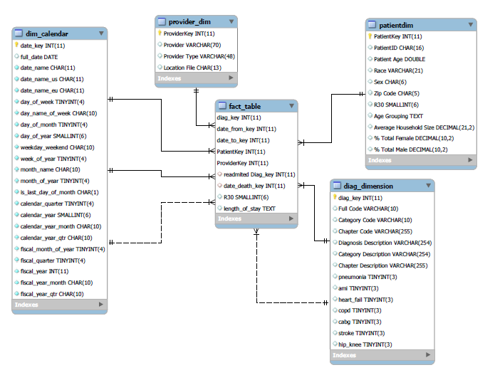
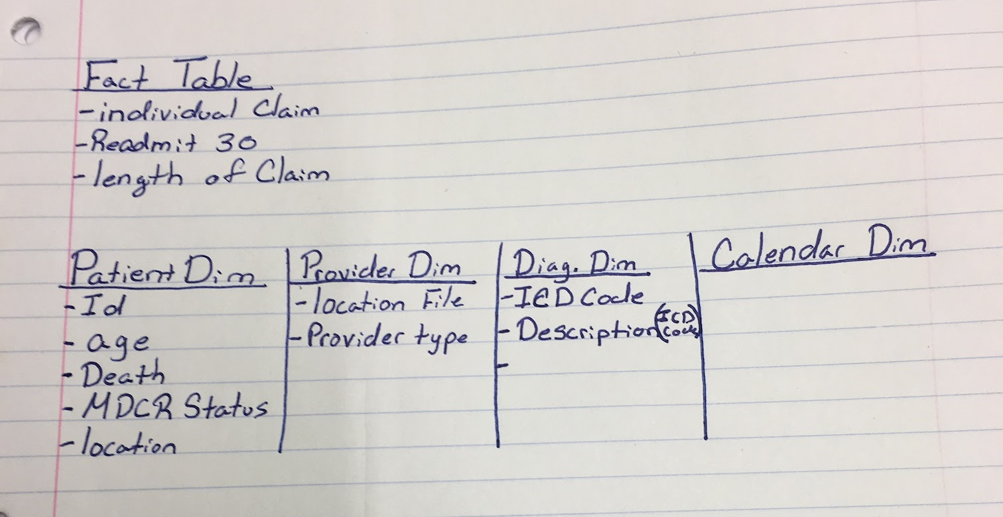
Modeling the Data
ER Diagram
Relational schema
Notes:
Trace

Slide 5
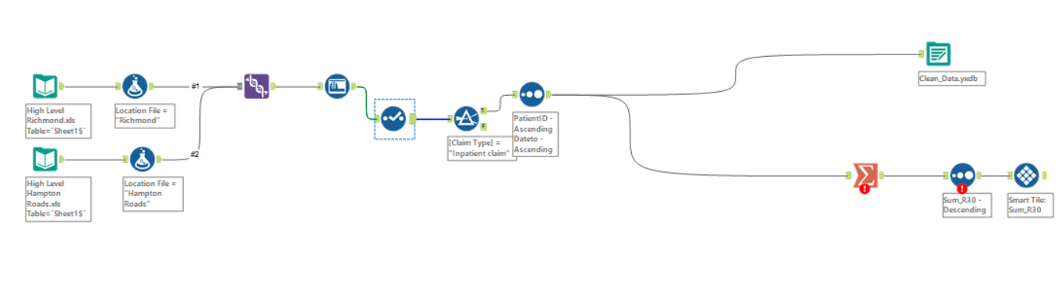
ETL
Notes:
Christine

Slide 6
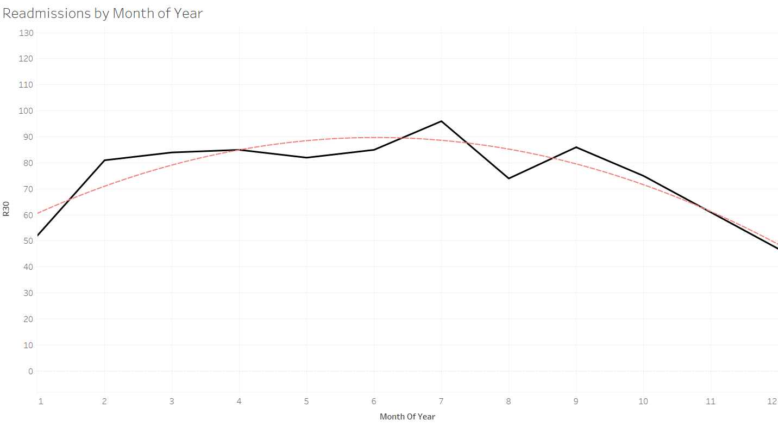
Visualizations
Notes:
Patrick

Slide 7
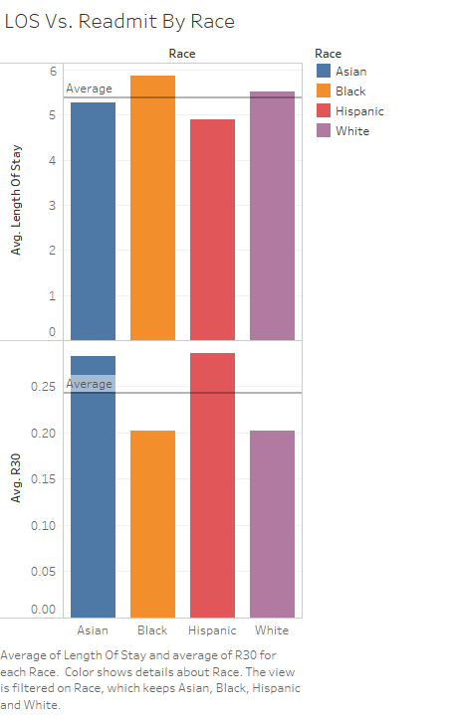
Notes:
Patrick

Slide 8
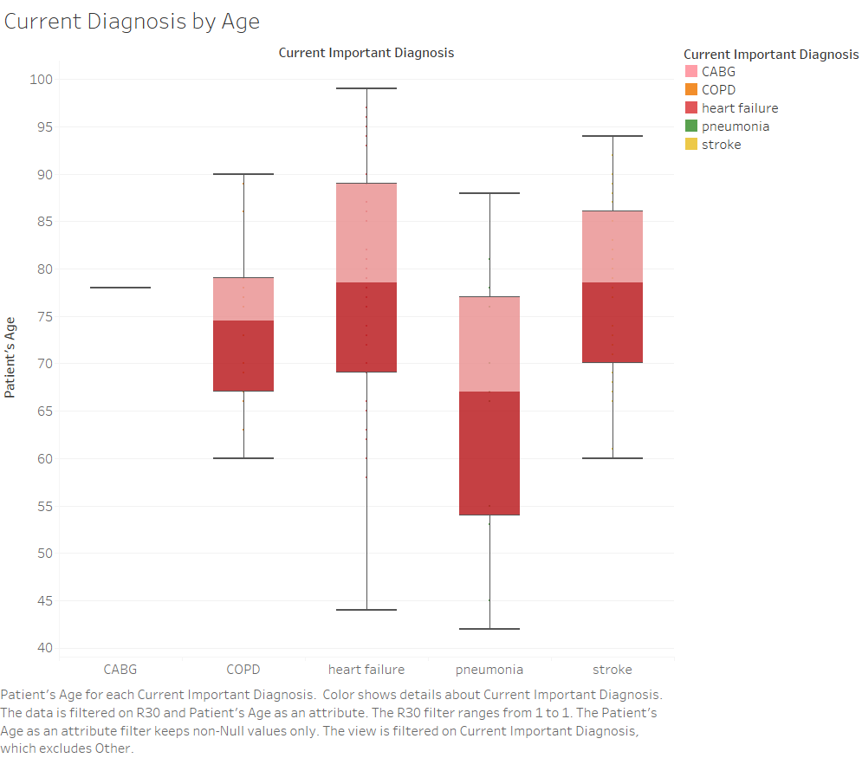
Notes:
Patrick

Slide 9
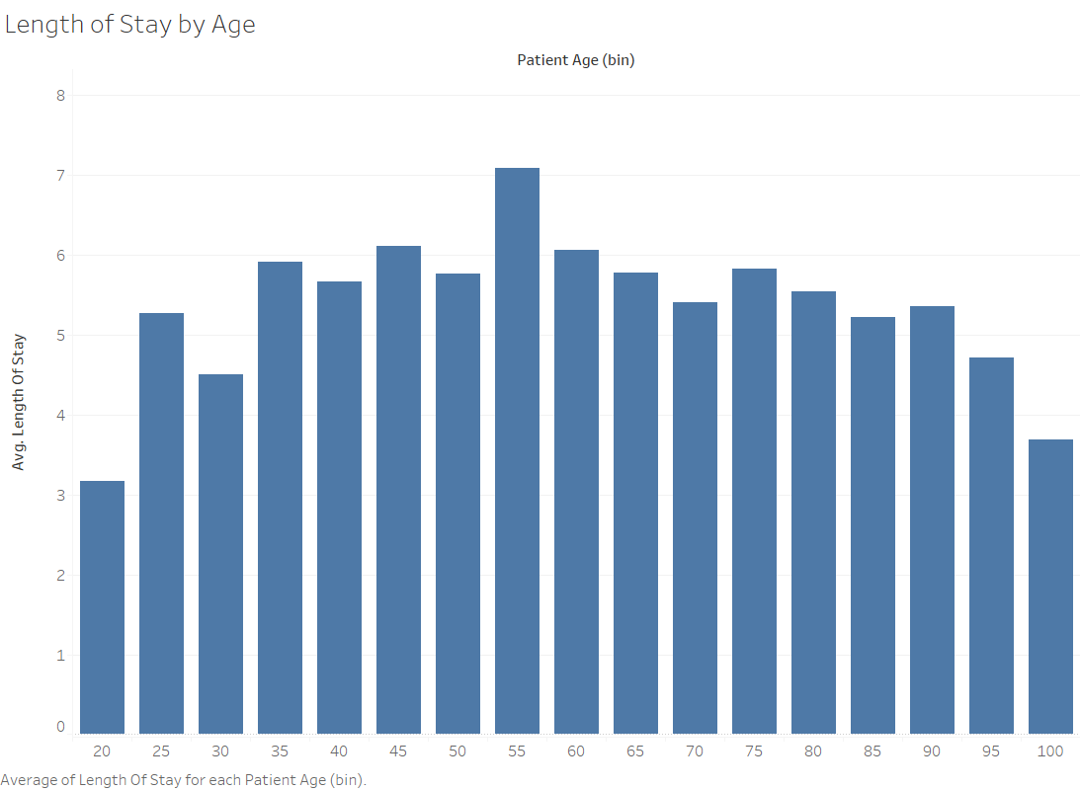
Notes:
Patrick

Slide 10
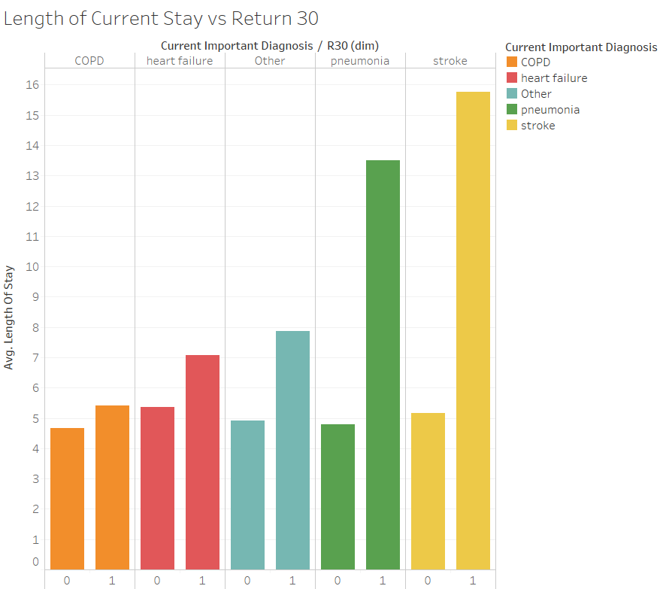
Notes:
Patrick

Slide 11
Bumps in the road
Inability to answer initial questions (lack of demographic diversity)
Initial combination of high level & detailed data
Led to duplicates
Jumping between .csv files, Alteryx, MySQL, Tableau
Notes:
Taylor

Slide 12
Conclusions
Cleaning the data = most difficult
Determining dimensions needed = easiest
If we did it all over again…
Combine high level & detailed data differently
Start earlier
Lower demographic diversity than we thought
There’s an ICD code for everything
Strokes lead to more readmissions
Notes:
Taylor
A narrative conclusion section that describes the group’s experience with the project (which steps were the most difficult? Which were the easiest? what did you learn that you did not imagine you would have? if you had to do it all over again, what would you have done differently?

